Slide 1
Master’s Thesis
Final Presentation
08.08.2024
Notes:
Hello I‘m … and welcome you to this thesis about ….
In cooperation with Bosch Smart Home company

Slide 2

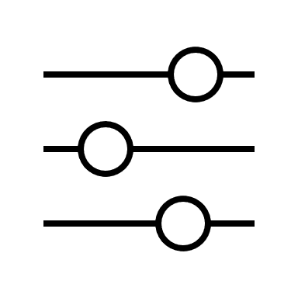


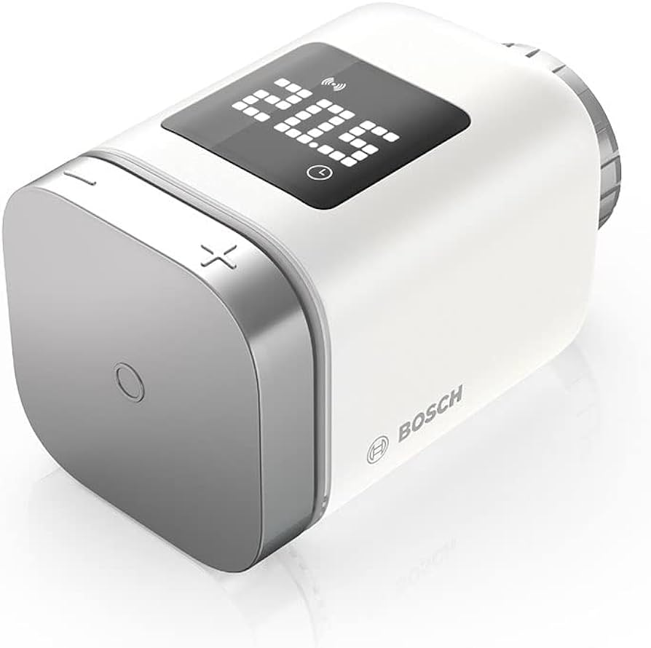

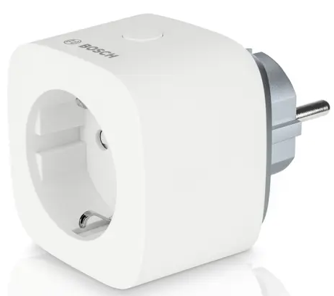
Motivation
Understand & Control
Optimize
Figure Sources [BOSCH]
Reduce Energy Costs
SHawn
…
Notes:
Growing adoption of smart home technologies → common user difficulties occur
Imagine a homeownder – Shawn, who has various SH devices to enhance convenience and energy efficiency in his home.
Hower, despite these investments Alex finds it challenging to understand why his energy bill stays high and how to optimize his smart home based on his habits.

Slide 3



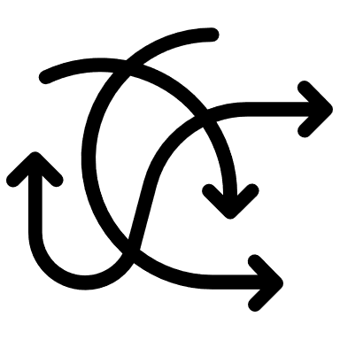

Motivation
Common Challenges Faced By Users
Time-consuming
Missing Technical Expertise
Complexity / Intransparancy
Notes:
Problems:
Time-consuming:
create automations for habits
analyze energy consumption
Getting overview of large amount of devices
Analyzing specific states like „is any window open“
Complexity/Intransparancy:
Understand the smart home and controling devices can be hard due to complexity and potential incosistencies/ missing transparency
Missing Technical Expertise:
Find it hard to create (complex) automations
Analyze energy consumption
→ Need to document temperature / power consumption
E.g. connect devices to Raspberry pi and monitor them
No tools for answering such questions in a SH

Slide 4







Motivation
Chatbot Figure Source [FLATICON]
Notes:
To address these interests of Shawn and the challenges mentioned:
This thesis explores development of a chatbot in the Bosch Smart Home ecosystem
Aiming to enhance explainability and user interaction
Automating and speed up the interests of users like Shawn
chatbot can assist users in understanding their smart home setup, providing clear explanations for device actions, and offering guidance on optimizing system performance.

Slide 5
Objective
Develop and investigate capabilities of a SH chatbot
Assist users with answering questions and actions
Provide explainability and better user experience to the user
Identify required components
Evaluate ability to address the defined use cases
Notes:
Develop and investigate capabilities of SH chatbot
With focus on low budget and open source
We will also talk about further requirements later

Slide 6




Outline
Motivation & Problem
Foundations & Related Work
Methodology
Concept & Implement.
Conclusion & Future Work
Evaluation & Discussion
Notes:
One Sentence to each point
We started with the energy cost problem and a SH chatbot could help in this scenario
Then we had a look at related work (SH chatbots / complex chatbots) and building blocks of chatbots in general
Subsequently we talked about the general goal to develop a SH chatbot for questions about a users SH environment and test ist capabilites
And just before we talked about the schedule and process throughout the thesis

Slide 7
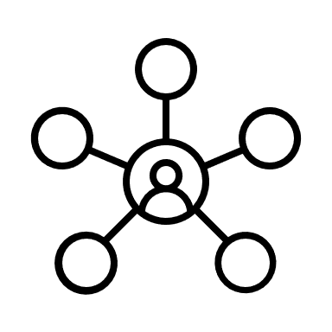



Foundations
Natural Language Understanding (NLU)
Connects human language and AI
Knowledge Base
Stores domain-specific data, facts, and contextual information
Enables chatbot to adress intents
Intent
Represents different user intentions that a chatbot anticipates
Enables comprehension of intents

Slide 8
Related Work
Similar Chatbot Approaches
Advancements in LLM Function Calling
Evaluation Methods
Notes:
SH chatbots:
Control devices & answers simple questions
Teaching without data sources, only based on user inputs…

Slide 9
Similar Chatbot Approaches: Relation to State of the Art
Chatbots for Smart Homes
Similar to known voice assistants
Chatbots for Complex Scenarios
Knowledge graph-based chatbot for linked data [AJ20]
Containerized network management chatbot [JQFF23]
Facebook chatbot [APM+20]
Teaching a SH assistant [CA21]
Chatbot controlling SH devices conntected to a Raspberry Pi [BKS17]
Chatbot for Data Science and Machine Learning [CCI+20]
Similar Chatbots
Home LLM: project for Home Assistant for controlling the smart home through a local LLM [aco24]
Notes:
SH chatbots:
Control devices & answers simple questions
Teaching without data sources, only based on user inputs…

Slide 10
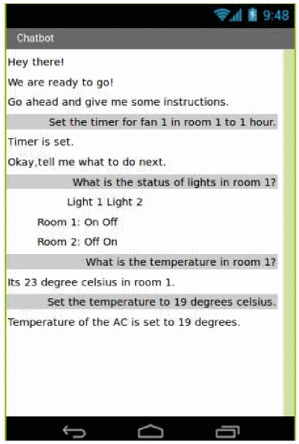
Relation to State of the Art
[BKS17]
Chatbots for Smart Homes
Answer only simple questions (regarding device information)
Notes:
Example what the chatbots are capable of

Slide 11
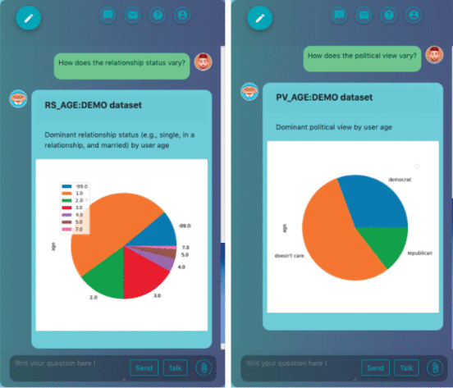
Relation to State of the Art
Chatbots for complex scenarios
[AJ20]
Notes:
This chatbot was capable of analyzing the underlying data upon user questions
Legends seem inappropiate but nothing was mentioned in the paper regarding this

Slide 12
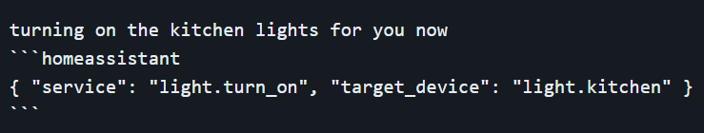
Relation to State of the Art
Similar Chatbots: Home LLM [aco24]
Key components:
Local LLM integration
Custom fine-tuned LLM (< 4b parameters)
Features:
Chat interface for device control and basic Q&A
Supports various backends (e.g., Ollama, LocalAI)
Training:
synthetic dataset for teaching function calling based on device information
Limitations:
Focused primarily on basic device control and simple queries
Uses tiny language models
Notes:
This chatbot was capable of analyzing the underlying data upon user questions
Legends seem inappropiate but nothing was mentioned in the paper regarding this

Slide 13
Relation to State of the Art
What is different in this thesis?
Exploring larger models (up to 12b)
Addressing more diverse and complex intents
Providing ready-to-use solution
Evaluating generalization without fine-tuning
Notes:
This chatbot was capable of analyzing the underlying data upon user questions
Legends seem inappropiate but nothing was mentioned in the paper regarding this

Slide 14
Relation to State of the Art
Advancements in LLM Function Calling
Recent Models
Gorilla (Llama-based)
NexusRaven (CodeLlama13b-based)
Key Improvements
Challenge
No function calling Standard
Surpassing commercial models like GPT4
Adaptability to changing documentation
Reduced Errors & Hallucinations
Notes:
Why is function calling important for this thesis?
Interesting is that both models are llama based
Changing documentation: Gorilla uses a „document retriever“ for adapting real time changes
Use JSON for function calling since usual models are able to generate json, but not every model supports functon calling

Slide 15
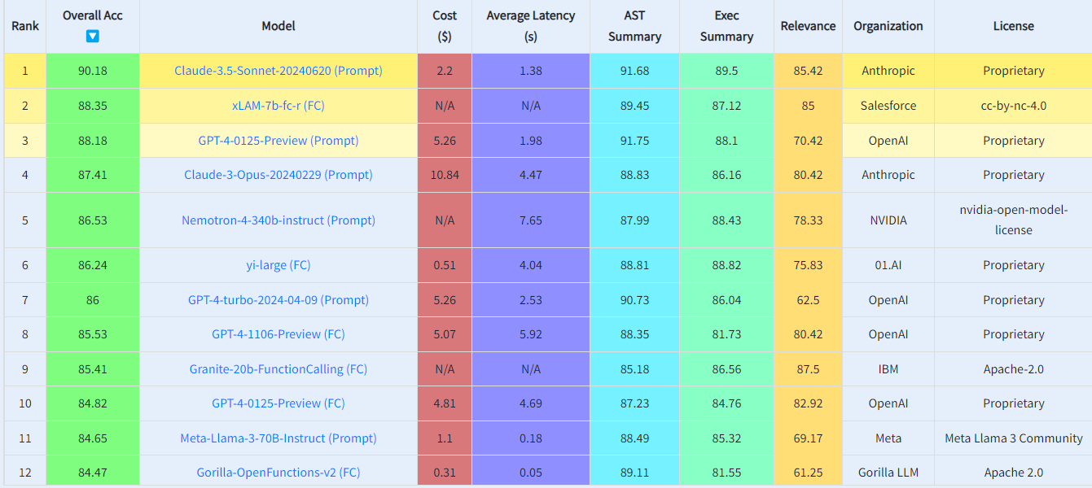
Related Work: Evaluation Methods
Berkeley Function Calling Leaderboard [YMJ+24]
Notes:
Comprehensive benchmark for function calling capabilities
Evaluates models on various function calling scenarios
Uses AST Evaluation for structural correctness
Employs Executable Function Evaluation for practical performance
Compares proprietary and open-source models

Slide 16
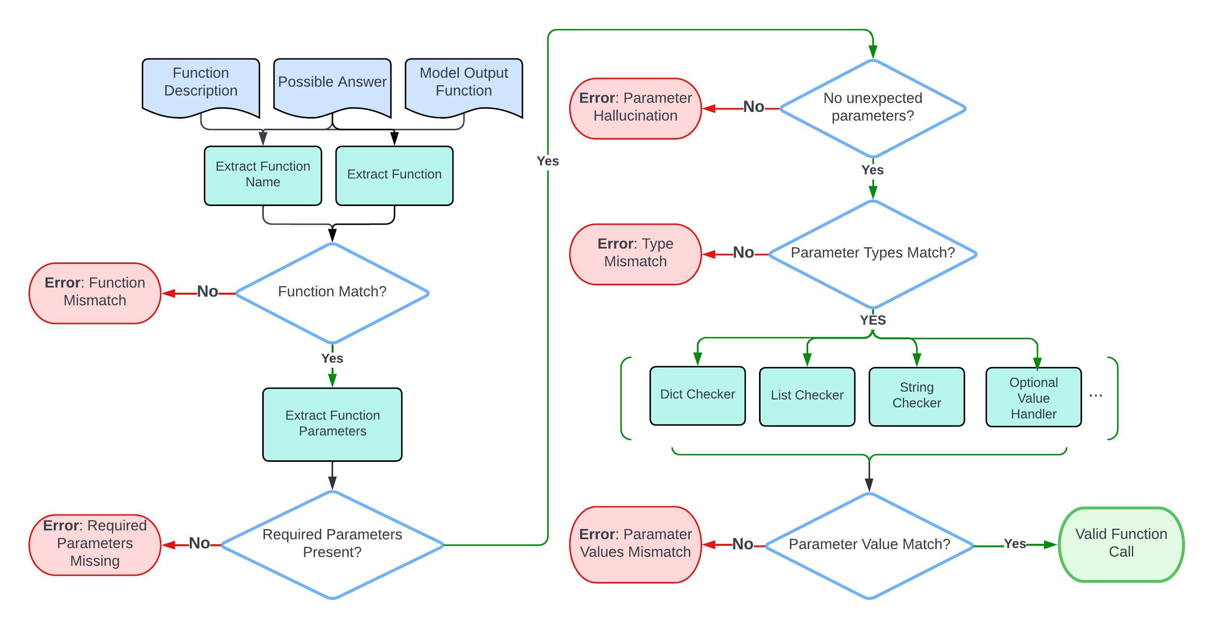
Related Work: Evaluation Methods
Berkeley Function Calling Leaderboard [YMJ+24]
Notes:
Comprehensive benchmark for function calling capabilities
Evaluates models on various function calling scenarios
Uses AST Evaluation for structural correctness
Employs Executable Function Evaluation for practical performance
Compares proprietary and open-source models

Slide 17
Outline
Motivation & Problem
Foundations & Related Work
Methodology
Concept & Implement.
Conclusion & Future Work
Evaluation & Discussion
Notes:
One Sentence to each point
We started with the energy cost problem and a SH chatbot could help in this scenario
Then we had a look at related work (SH chatbots / complex chatbots) and building blocks of chatbots in general
Subsequently we talked about the general goal to develop a SH chatbot for questions about a users SH environment and test ist capabilites
And just before we talked about the schedule and process throughout the thesis

Slide 18
Methodology
Design Science
Explorative Empirical Research
Literature Review
Preliminary Surveys
User Survey for Chatbot Inputs
Iterative Prototype Development
Mixed-Methods Evaluation
Notes:
Design Science: Iterative development, problem-solving, software engineering research.
Empirical Research: Understanding user requirements, gathering real-world data.
Literature Review:
Building blocks and function calling in language models.
Similar chatbot approaches
Evaluation techniques for language model-based chatbots.
User Survey for inputs
Conducted survey with 13 participants for diverse inputs.
Collected typical queries in German and English.
Improved chatbot's understanding and performance with real user data.
Mixed-Methods Approach:
Quantitative metrics for model performance and data from a user/case study
Qualitative analysis of semi structured interviews
I was missing in other studies: Is such a chatbot even necessary, does it help the users, do they want to use something like this?
Or is it just the typical “use GenAI” for anything

Slide 19
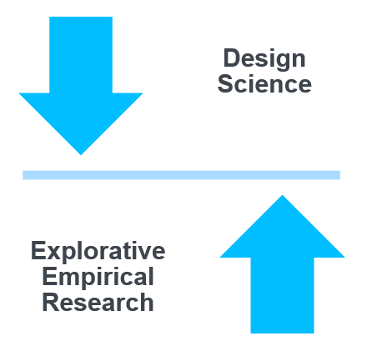
Outline
Motivation & Problem
Foundations & Related Work
Methodology
Concept & Implement.
Conclusion & Future Work
Evaluation & Discussion
Notes:
One Sentence to each point
We started with the energy cost problem and a SH chatbot could help in this scenario
Then we had a look at related work (SH chatbots / complex chatbots) and building blocks of chatbots in general
Subsequently we talked about the general goal to develop a SH chatbot for questions about a users SH environment and test ist capabilites
And just before we talked about the schedule and process throughout the thesis

Slide 20
Concept
Intents
Basic Intents (Iteration 1)
Get Device Status
Examples:
“What is the temperature in the living room?”
Entities: DeviceType, Room
Action/Response: Provide device status (e.g., temperature, power status).
Examples:
“Set the temperature to 22 degrees in the living room.”
Entities: DeviceType, Room, DesiredStatus, DesiredValue
Action/Response: Change device status (e.g., adjust temperature, turn lights on/off).
Intermediate Intents (Iteration2)
Assistance for Creating Automations
Function: Simplify setup of smart home automations using natural language
Interpret Device Control
Function: Provide explanations for device actions to improve transparency.
Complex Intents:
Analyzing Energy Consumption
Function: Offer insights into energy usage patterns for optimization and cost reduction.
Set Device Status

Slide 21
Concept
Preliminary Surveys
Gain Knowledge, Requirements and Ideas
Discussion of Intents
Tools/
Technologies
Data
Evaluation
Challenges
Notes:
Feasibility and Considerations:
Technical feasibility supported with a preference for using proven frameworks.
Importance of simplifying user interactions and understanding user patterns.
Privacy and trust concerns impacting market viability.
Proposed Intents:
Device control and status querying.
Automation assistance for scheduling and explaining actions.
Energy management insights and optimization.
User-specific recommendations based on behavior.
Tools and Technologies:
Consideration of LLM vs. NER for capabilities and resource constraints.
Recommendations for frameworks like Microsoft Bot Framework, Dialogflow, and LangChain.
Importance of robust data management and input interpretation.
Data Organization:
Use of predefined configurations mapping intents to actions.
Gathering diverse user inputs for training models and performance evaluation.
Leveraging logs from smart home devices and user behavior data.
Challenges and Pitfalls:
Complexity in creating sophisticated automations.
Addressing data privacy and trust issues.
Ensuring sufficient computational resources and managing development costs

Slide 22
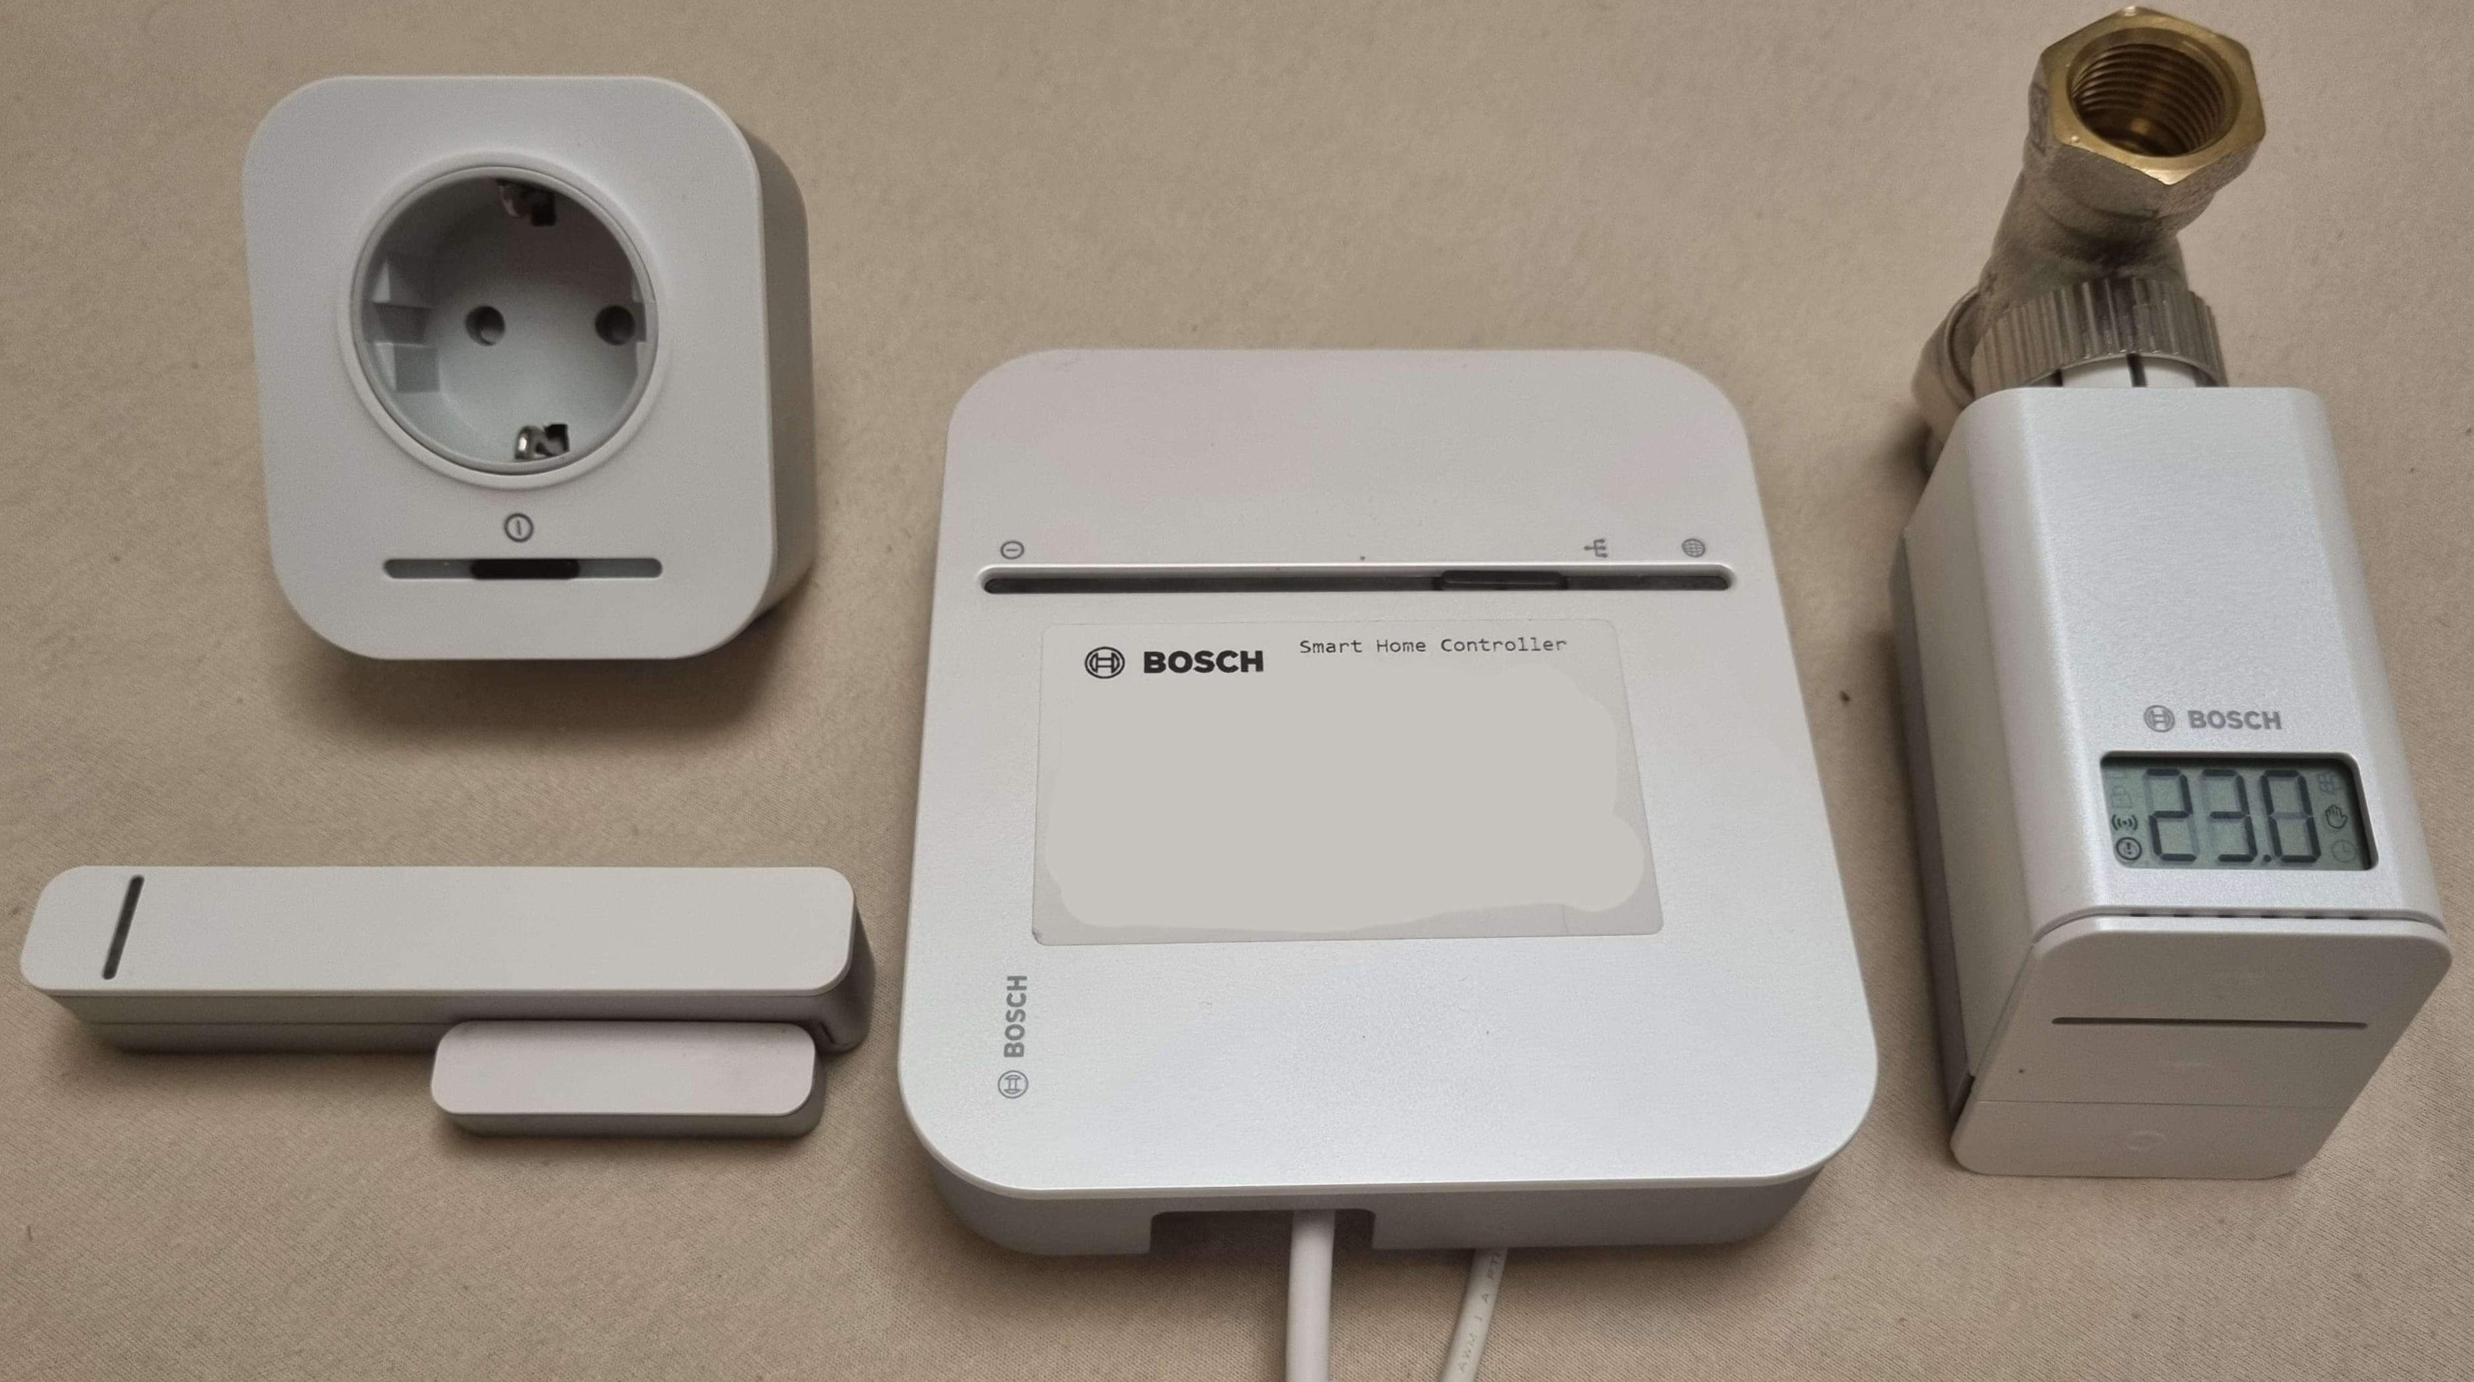

Concept
Setup

Slide 23
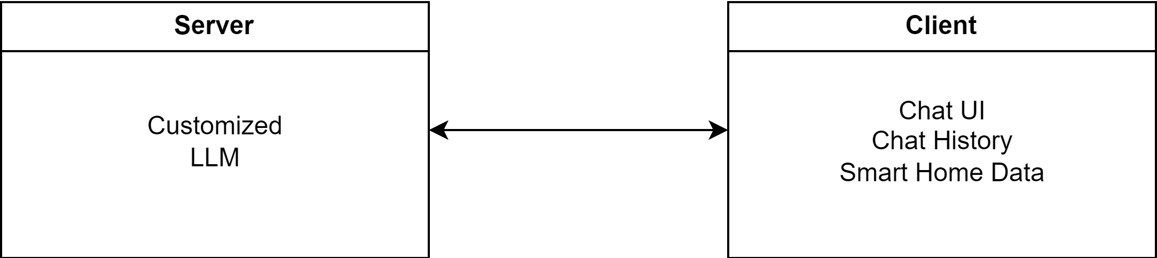
Concept
Architecture

Slide 24
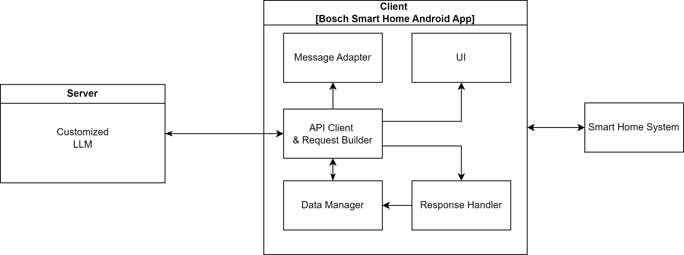
Concept
Architecture

Slide 25
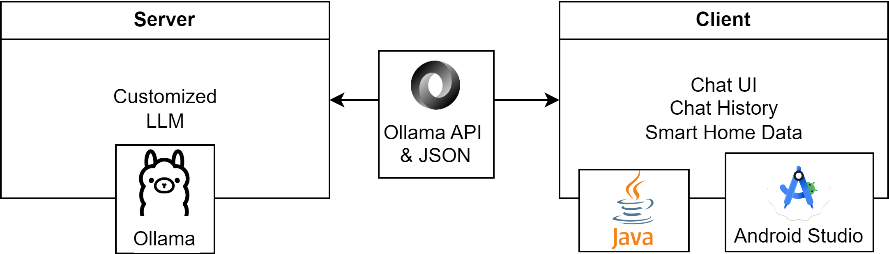
Implemenation
Overview

Slide 26

Implemenation
LLM Customization
FROM llama3:instruct
PARAMETER temperature 0.95
SYSTEM “””
You are 'SHBot' (Smart Home Bot), a helpful AI Assistant that controls smart home devices. Complete tasks or answer questions based on a provided device list. “””
MESSAGE user Can you turn on my TV? MESSAGE assistant Sure, turning on the TV now. { "action": "turn-on", "deviceID": "device123", "device": "POWER_METER_SWITCH", "room": "Schlafzimmer", "name": "TV" }
Modelfile
Model
Parameters
System Message
Example Chats
Notes:
Tried out many different model in size 1B to 15B

Slide 27
Implemenation
Example Device List containing only a Smart Plug
Data
[{
"type": "POWER_METER_SWITCH",
"name": "Office Desk Lamp",
"deviceID": "12345",
"state": [
{
"id": "PowerMeter",
"state": {
"powerConsumption": 10,
"energyConsumption": 50
}
},
{
"id": "PowerSwitch",
"state": {
"switchState": "ON"
}
}
],
"room": "Office"
}]
Base Structure of each POST Request
POST http://<domain-placeholder>/api/chat { "model": "<model-placeholder>", "messages": [ { "role": "user", "content": "<device-list-placeholder>" }, { "role": "user", "content": "<user-message-placeholder>" } ], "stream": true }

Slide 28
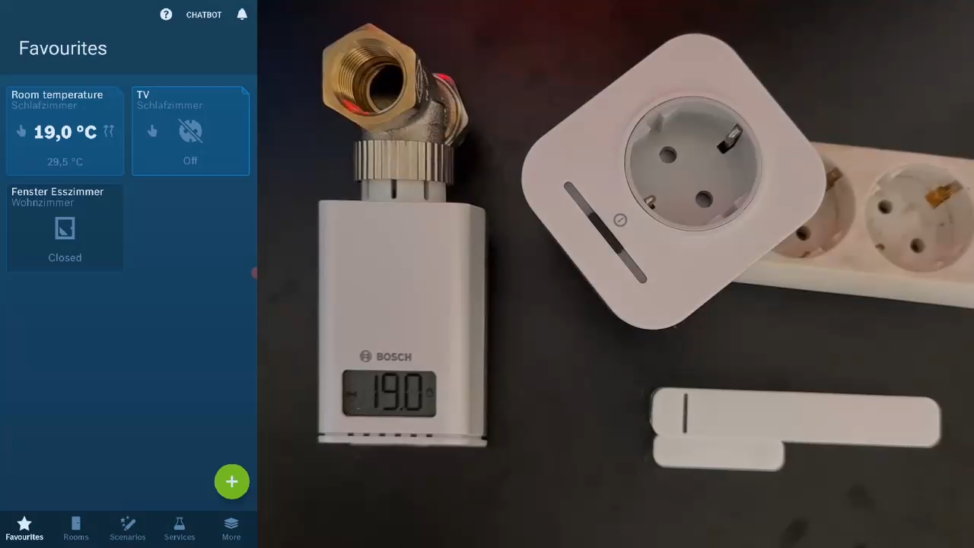
Implemenation
Demonstration

Slide 29
Outline
Motivation & Problem
Foundations & Related Work
Methodology
Concept & Implement.
Conclusion & Future Work
Evaluation & Discussion
Notes:
One Sentence to each point
We started with the energy cost problem and a SH chatbot could help in this scenario
Then we had a look at related work (SH chatbots / complex chatbots) and building blocks of chatbots in general
Subsequently we talked about the general goal to develop a SH chatbot for questions about a users SH environment and test ist capabilites
And just before we talked about the schedule and process throughout the thesis

Slide 30
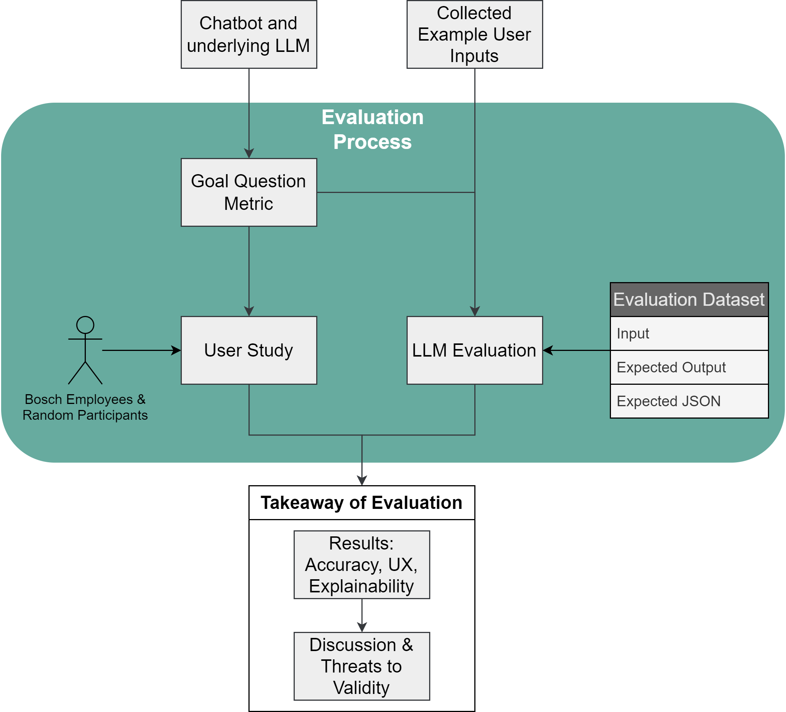
Evaluation Process
Notes:
Needed to create a dataset for evaluation
Example input messages used from survey
Created 10 device list, some random, some edge cases

Slide 31
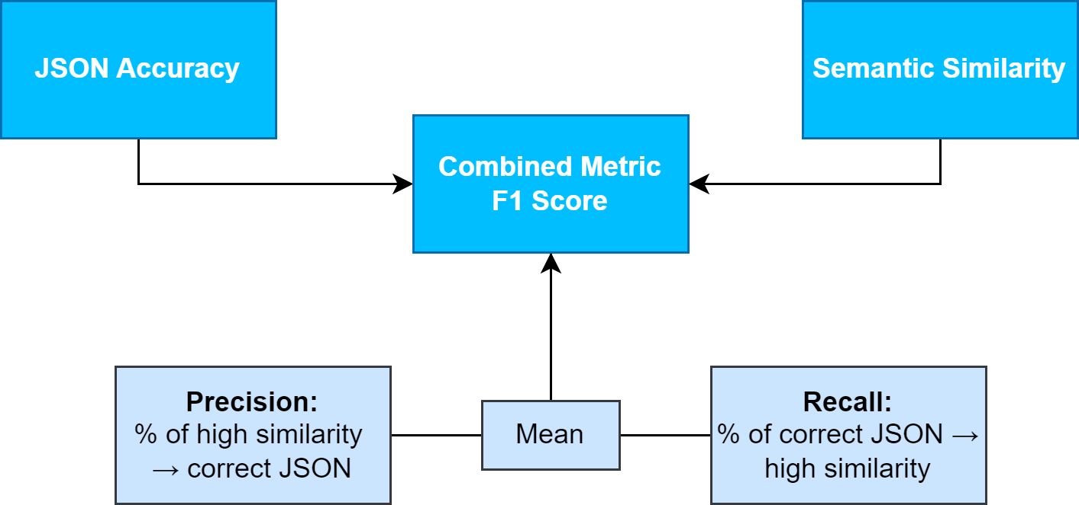
Model Evaluation
Metrics
Notes:
True Positive (TP): Cases where the model’s output has high semantic similarity (above a defined threshold) and the generated JSON is correct.
False Positive (FP): Cases where the model’s output has high semantic similarity but the generated JSON is incorrect.
True Negative (TN): Cases where the model’s output has low semantic similarity and the generated JSON is incorrect.
False Negative (FN): Cases where the model’s output has low semantic similarity but the generated JSON is correct.
Based on these definitions, we calculate precision, recall, and F1 score as follows:
Precision: Of all the outputs the model that have a high semantic similarity, how many were actually positive cases (generated JSON is also correct).
Recall: Of all the actual positive cases (generated JSON is correct), how many did the model correctly identify as positive (semantic similarity is also high).
F1Score: The harmonic mean of precision and recall, providing a single measure of performance.

Slide 32
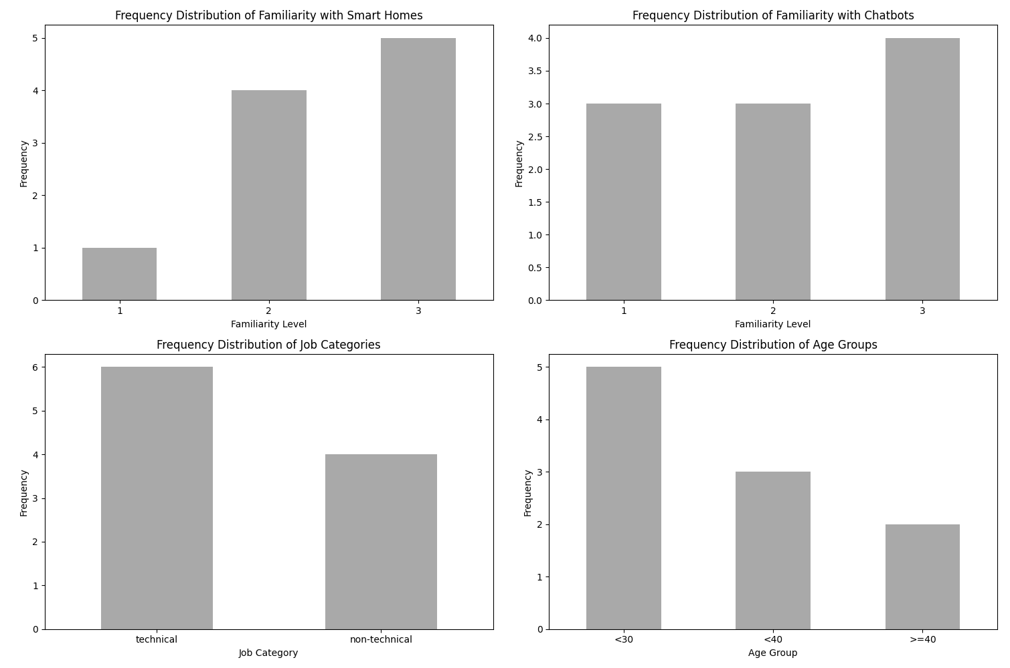
User Study
Participants

Slide 33
User Study
Procedure & Metrics
Tasks
Asking the chatbot what it is for
Likert-Scale Survey
Ease of Use
Semi-structured Interview
2 device control tasks
3 information gathering tasks
Measuring completion time, attempts, succesfullness
User Experience
Suggestions for Improvement
Additional Functionalities
Are Responses clear/helpful?
Would users use the chatbot?
Better Usability?
Quantitative Data
Qualitative Data

Slide 34
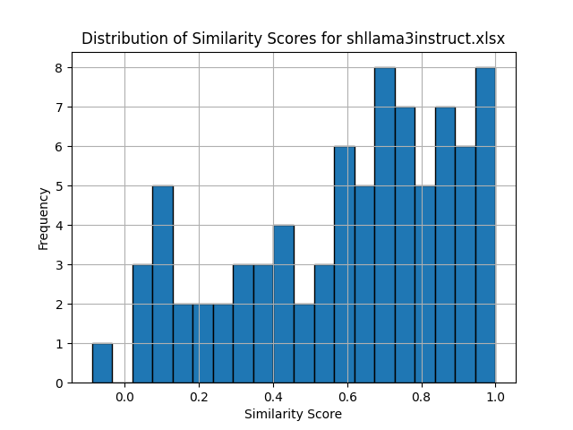
Results
Model Performance
What is a good Value?
Example with 0.61:
Response:
“I cannot have a temperature measurement for the kitchen. There are only rooms and devices, but no temperature-taking devices available for the kitchen.”
Expected:
“I’m sorry, but no temperature sensors are available in the kitchen”
Another Aspect: Answering in users‘ language

Slide 35
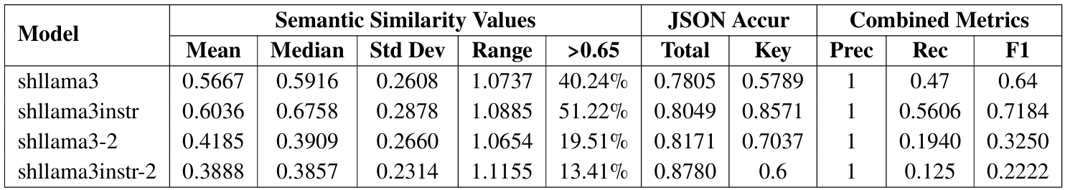
Results
Model Performance

Slide 36
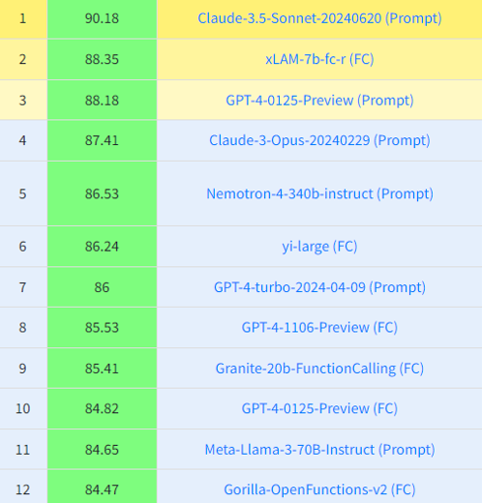
Discussion
Model Performance
Can compete with general much larger models?
Can compete with fine tuned Home LLM?
Claims to have 97.11%
Only JSON Accuracy Comparison possible
Model | Accuracy
shllama3 | 0.7805
shllama3instr | 0.8049
Shllama3-2 | 0.8171
Shllama3-instr-2 | 0.8780

Slide 37



Results
User Study Hypothesis
𝐻1 The chatbot improves explainability of the app.
𝐻2 The chatbot improves usability of the app.
𝐻3 Persons would rather use the chatbot than traditional ways of controlling their smart home.
𝐻4 Controlling device tasks generally take longer than tasks where no action needs to be triggered.
Analysis through Wilcoxon Test but qualitative findings also support this.
Notes:
Hypothesis 1: The chatbot improves explainability of the app
Strong Support: Significant results in Q4 (p-value = 0.0097) and Q5 (p-value = 0.0139) indicate that users found the chatbot’s responses clear and helpful, and the smart home’s behavior understandable after chatbot interactions.
Statistical Evidence: The Wilcoxon test results provide strong support for improved explainability​(6_Evaluation)​.
Hypothesis 2: The chatbot improves usability of the app
Moderate to Strong Support: Q3 showed a p-value of 0.0532, suggesting a trend towards improved usability, though not statistically significant.
User Perception: Users generally found the chatbot intuitive and easy to use, with a mean score of 4.20 for ease of use​(6_Evaluation)​.
Hypothesis 3: Persons would rather use the chatbot than traditional ways of controlling their smart home
No Support: Q6 showed a non-significant result (p-value = 1.0000), indicating no strong preference for the chatbot over traditional methods.
Integration Potential: Neutral mean score (3.00) suggests users see value but are not fully convinced of its superiority​(6_Evaluation)​.
Hypothesis 4: Controlling device tasks generally take longer than tasks where no action needs to be triggered
Strong Support: Significant results for task completion times (T5 and T6 vs T1-T4) with p-values of 0.0039 and 0.0020, respectively, showing device control tasks took longer than information retrieval tasks​(6_Evaluation)​.
The Wilcoxon signed-rank test for hypothesis 4 involves comparing two sets of related samples to evaluate whether their population mean ranks differ. For hypotheses 1, 2, and 3, the tests compared pre- and post-intervention scores on various usability and explainability metrics.

Slide 38
Discussion
Quantitative Results:
High satisfaction scores for system explainability and ease of use.
However, a neutral score of 3 for using the chatbot
Qualitative Insights:
Positive feedback on interaction, especially for giving an overview of devices.
Device Control task took significantly longer
User perceptions: high scores for usability (4.20) and clarity (4.20), supporting hypotheses H1 and H2
Strong interest in using the chatbot for complex tasks, device management, and system optimization
Privacy concerns from some participants

Slide 39





Key Findings / Contributions
Performance Trade-off
Enhanced Explainability and Usability
Designed Example Architecture
User Preference: under construction
High-Value Use Cases: multi-device management, automations, energy analysis
Notes:
Best model: shllama3instr - balanced performance
Improved explainability and usability
Not yet preferred over traditional interfaces

Slide 40
Threads to Validity
Construct Validity
Potential errors in evaluation dataset
Limitations in JSON evaluation script
Internal Validity
Participant bias due to familiarity with Bosch Smart Home
Learning effect influencing task completion times
External Validity
Limited participant diversity and small sample size (n=10)
Specific device setup may not generalize
Reliability
Subjectivity in qualitative analysis
Metrics choice and implementation variability

Slide 41
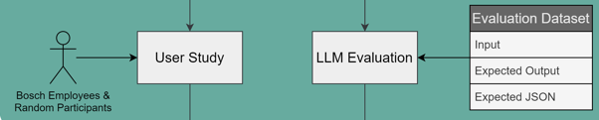
Outline
Motivation & Problem
Foundations & Related Work
Methodology
Concept & Implement.
Conclusion & Future Work
Evaluation & Discussion
Notes:
One Sentence to each point
We started with the energy cost problem and a SH chatbot could help in this scenario
Then we had a look at related work (SH chatbots / complex chatbots) and building blocks of chatbots in general
Subsequently we talked about the general goal to develop a SH chatbot for questions about a users SH environment and test ist capabilites
And just before we talked about the schedule and process throughout the thesis

Slide 42
Motivation & Problem
Foundations & Related Work
Methodology
Concept & Implement.
Conclusion & Future Work
Evaluation & Discussion

Slide 43
Future Work
Advanced Models and Fine-Tuning
Enhanced Data Presentation
Integration of System Logs and Historical Data
User Interaction and Acceptance
Notes:
Advanced Models and Fine-Tuning
Explore larger parameter models.
Implement advanced fine-tuning/training approaches.
Enhanced Data Presentation
Develop more readable formats for device data presentation.
Improve performance through optimized data formats.
Integration of System Logs and Historical Data
Incorporate system logs and historical data functionalities.
Research effective data presentation and filtering methods.
User Interaction and Acceptance
Investigate the impact of visual elements and voice interaction.
Conduct larger-scale user studies with diverse participants.
Trust/Security?

Slide 44
Q&A
Notes:
End the presentation with this slide
Open for a discussion now
So, how can I help you?

Slide 45
Extra Slides & References

Slide 46
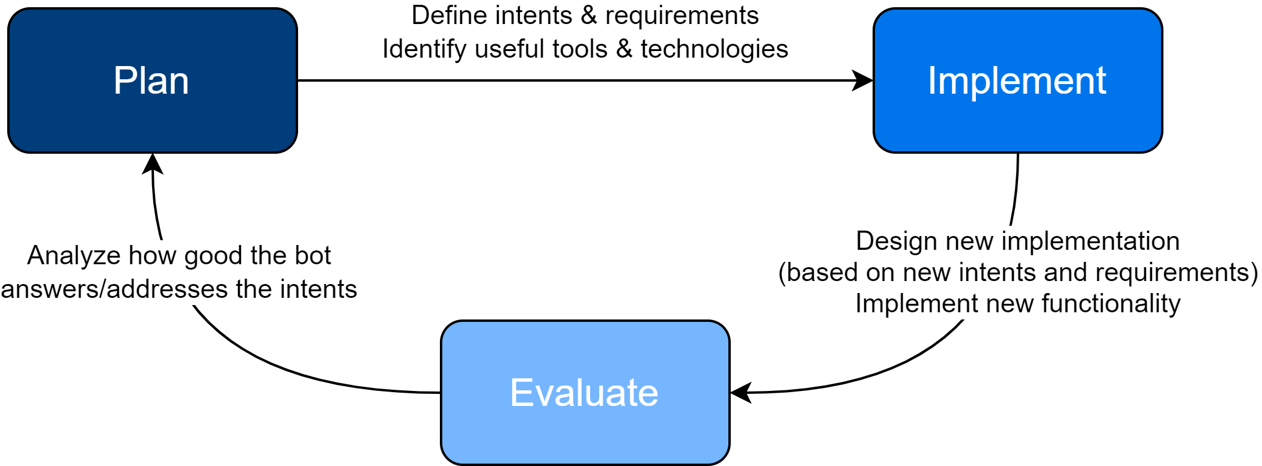
Work Plan & Schedule
Notes:
The underlying process is iteratively designed
Based on extreme programming release cycle and prototype development
Just describe the process…

Slide 47
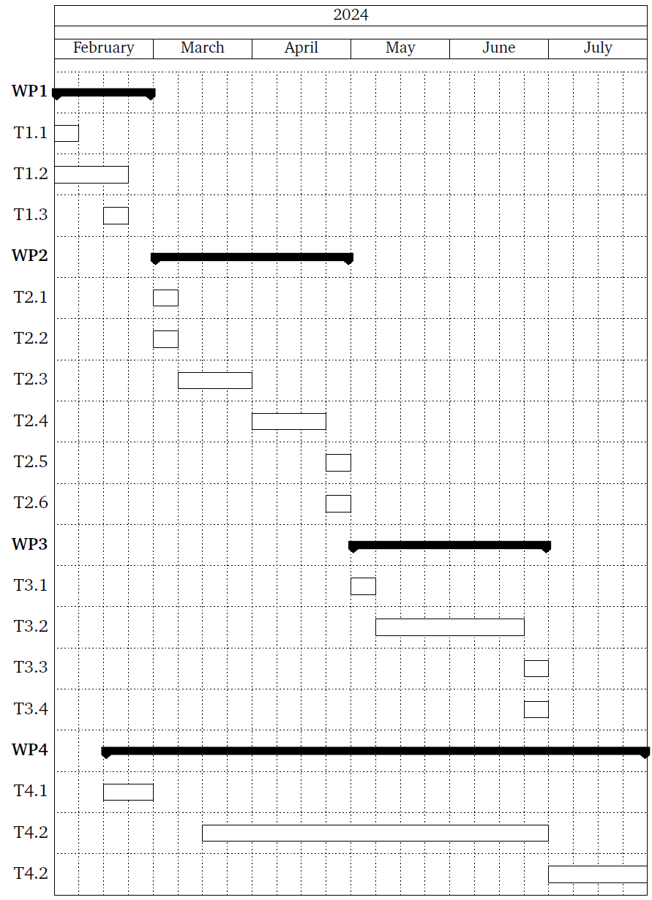
Work Plan & Schedule
Literature & Tool Research
Initial Iteration of Prototype Development
Further Iterations
Documentation
Notes:
Literature & tool research:
Deeper insight into chatbot development and architecture
Iterations:
2 months
Plan -> Implement -> evaluate
Implement has the longest duration
Iteration duration only estimated
Could be a single iteration in worst case
Documentation in parallel to write a draft
Refined at the end

Slide 48
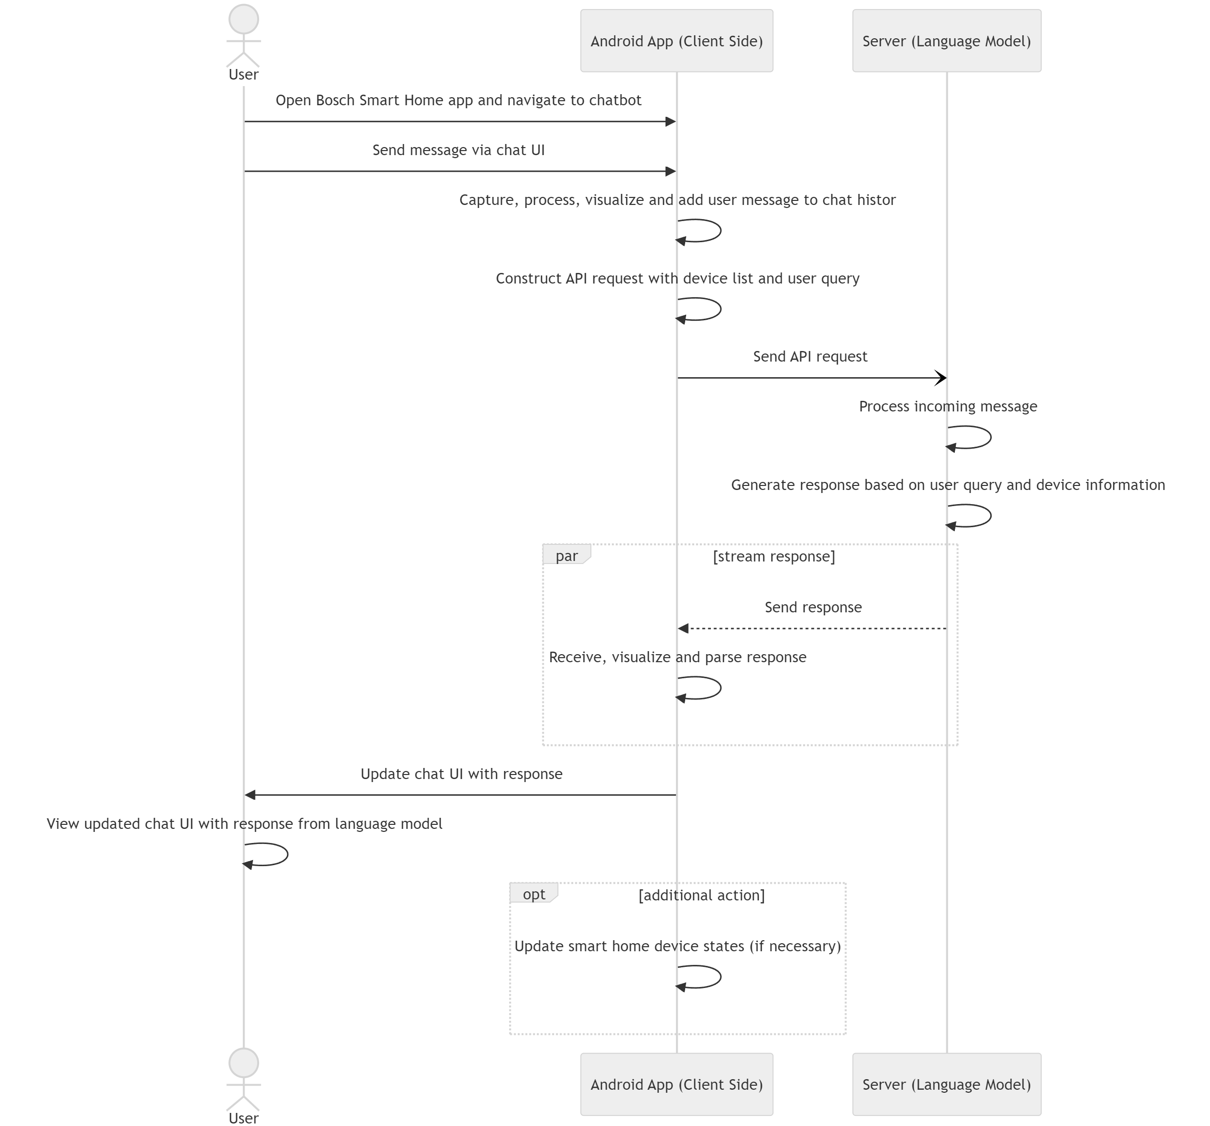
Implemenation
Interaction Flow

Slide 49
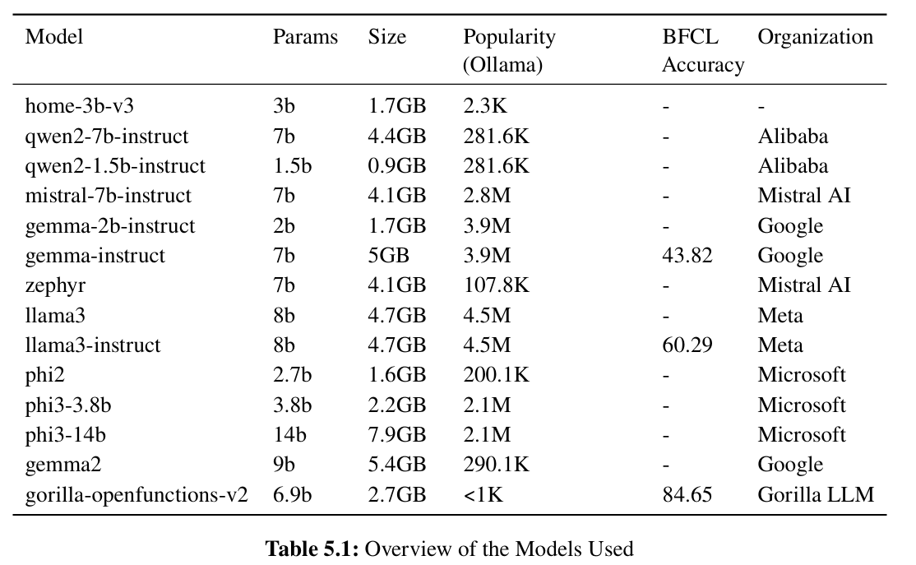
Implemenation
Models used

Slide 50
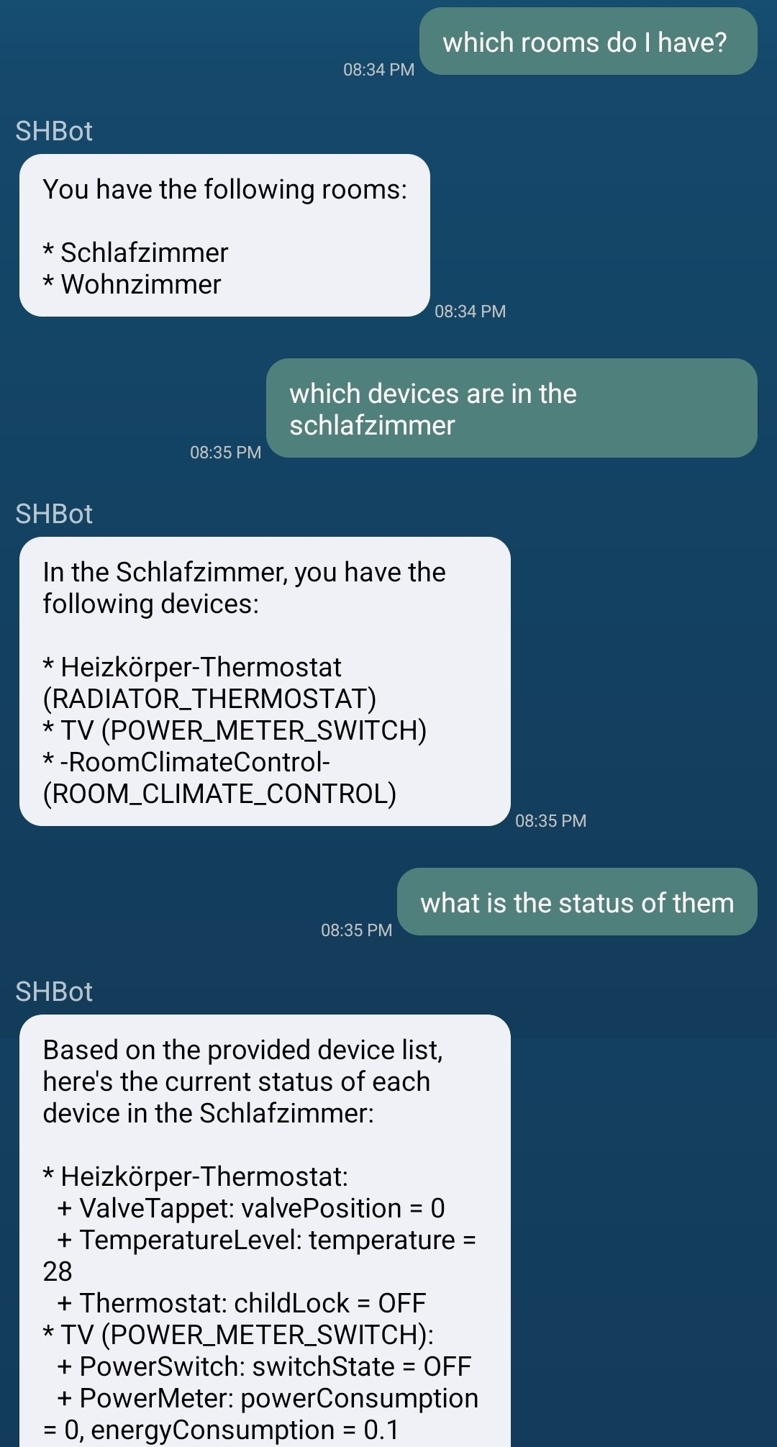
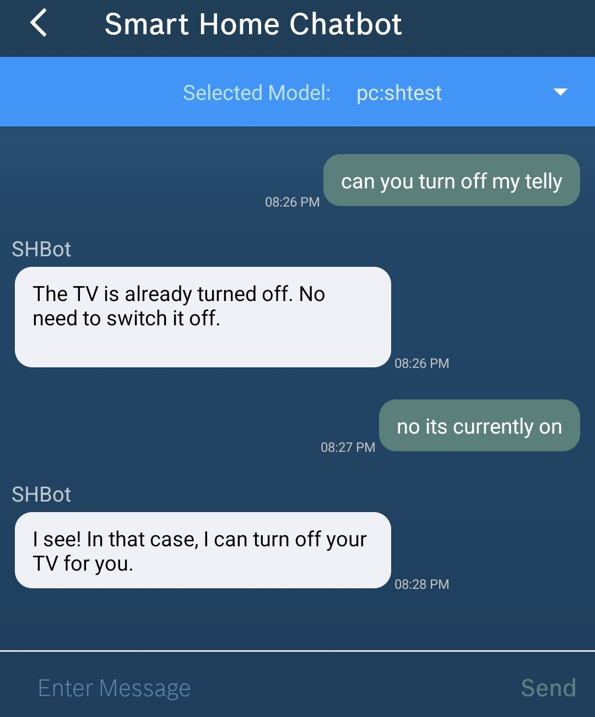
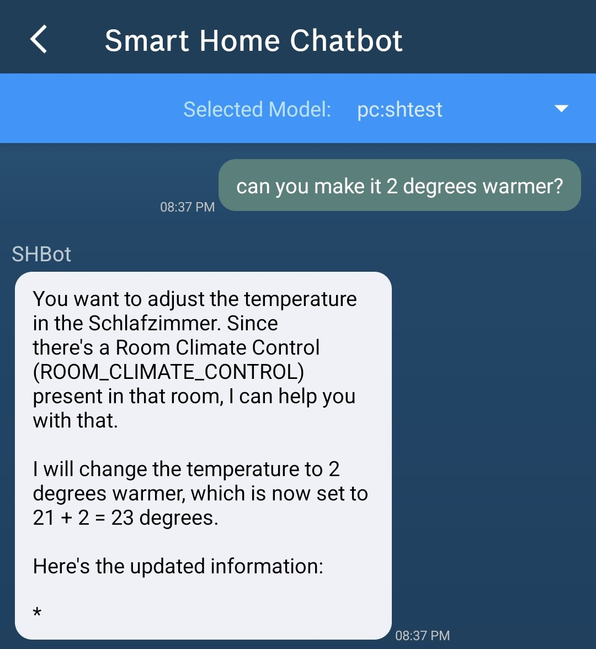
Example Chats
Notes:
…

Slide 51
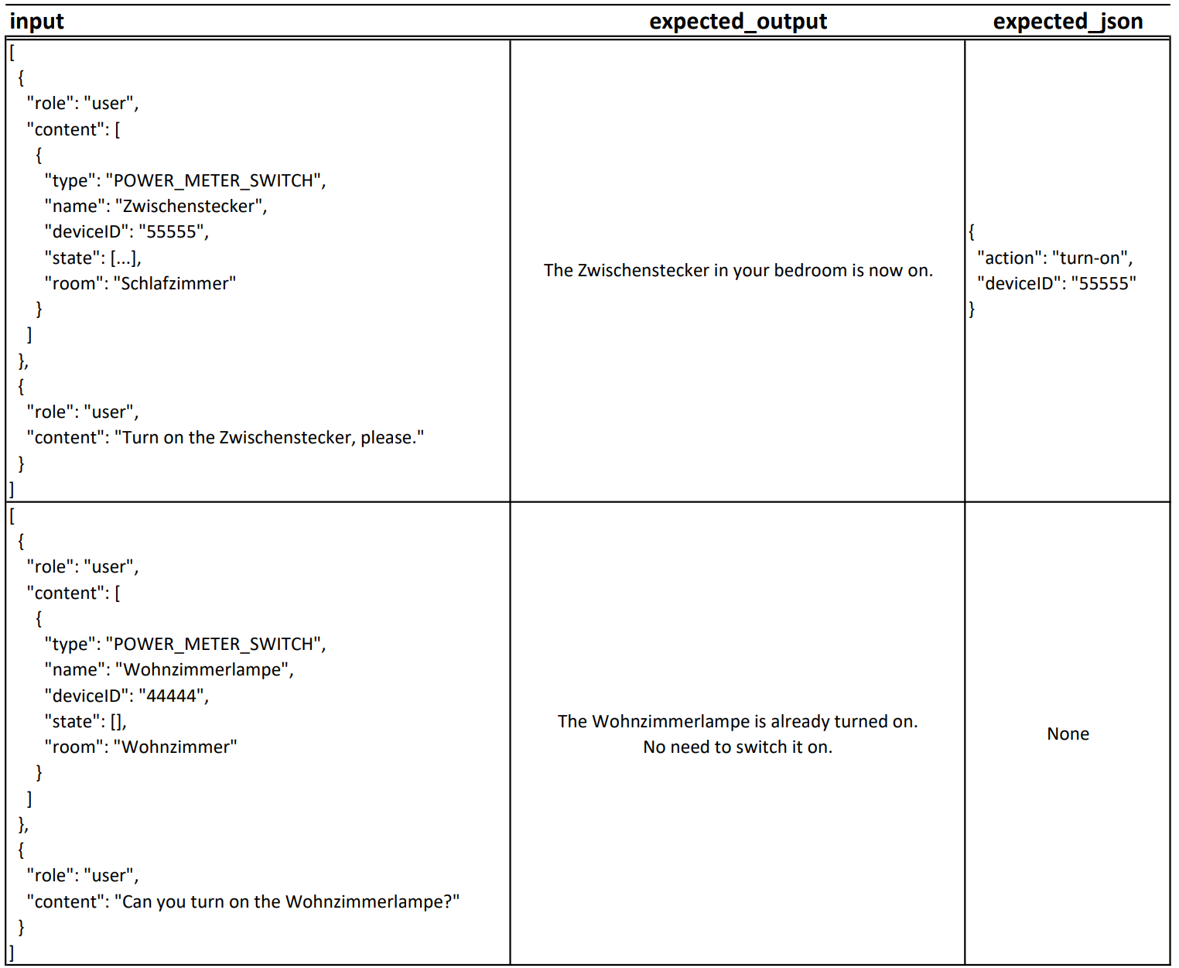
Dataset Example Entries

Slide 52
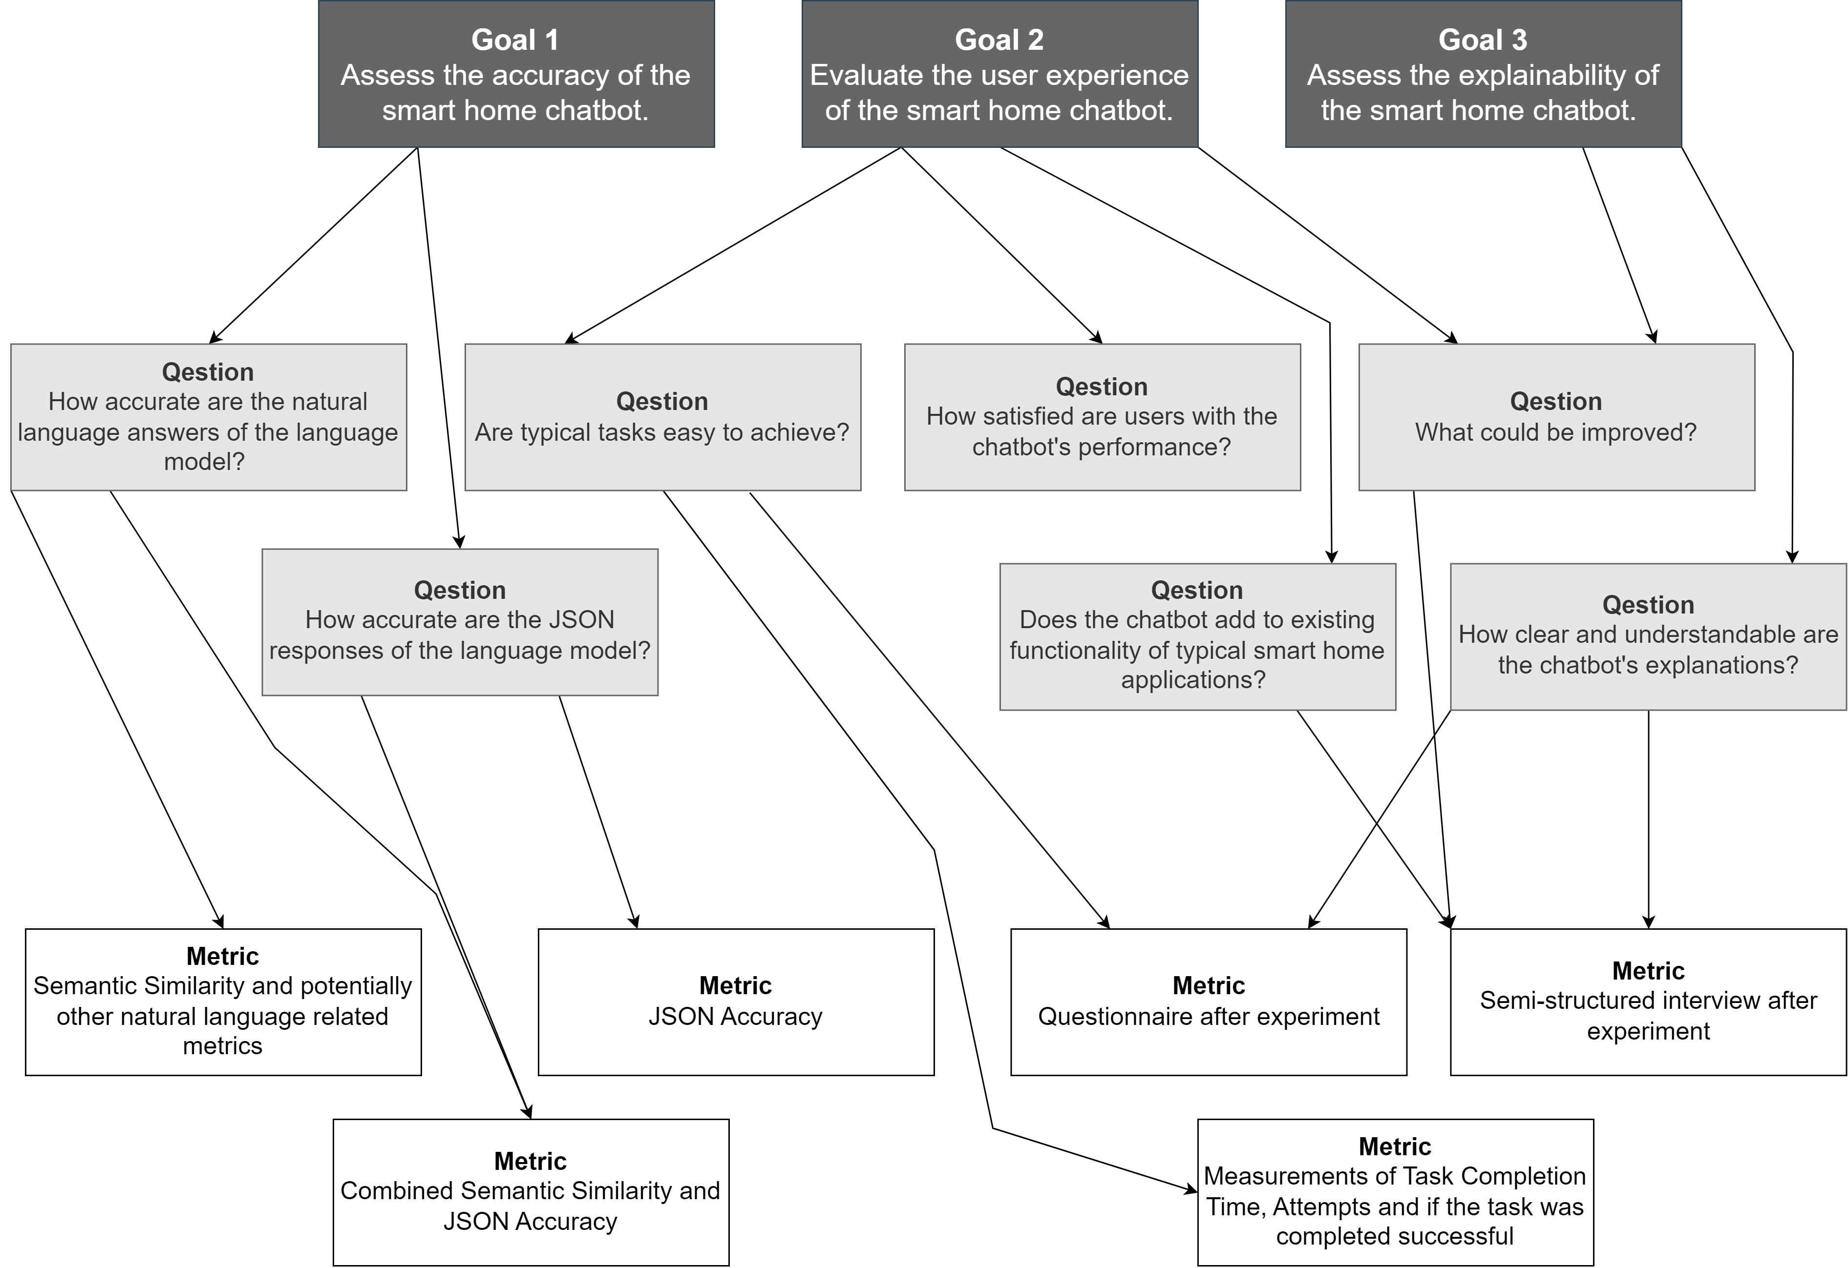
Goal Question Metric

Slide 53
Detailed WPs
WP2 Initial Iteration of Prototype Development
Define Key Features, Functionalities, Intents
Translate Concepts into Design/Development
Develop&Implement initial chatbot architecture
Design&Implement knowledge base
Evaluate Prototype’s performance
Plan for future iterations
WP3 Further Iterations
Define new and refine features/intents
Implement new functionality
Evaluate Prototype‘s performance
Plan future iterations/work

Slide 54
Research Questions for Iterations
RQ2.1 What are the key features, functionalities and intents required for the initial iteration of the chatbot prototype?
RQ2.2 How can the identified chatbot concepts and architectures from the literature research be effectively translated into the design and development of the prototype?
RQ2.3 How could the architecture of our chatbot look like?
RQ2.4 How does the knowledge base need to look like for the defined intents and how can the necessary data be provided?
RQ2.5 What challenges and limitations arise during the initial development phase, and how can they be addressed?
RQ2.6 To what extent can the initial prototype effectively address and answer predefined intents, and what improvements or adjustments are necessary for enhanced performance?
RQ2.7 What could be done to improve the prototype in future iterations?

Slide 55
Research Questions for Iterations
RQ3.1 What advanced features or rather intents could be implemented?
RQ3.2 Are changes in architecture and the knowledge base needed?
RQ3.3 Are there features or intents that can not be implemented?
RQ3.4 To what extent can the initial prototype effectively address and answer predefined intents, and what improvements or adjustments are necessary for enhanced performance?

Slide 56
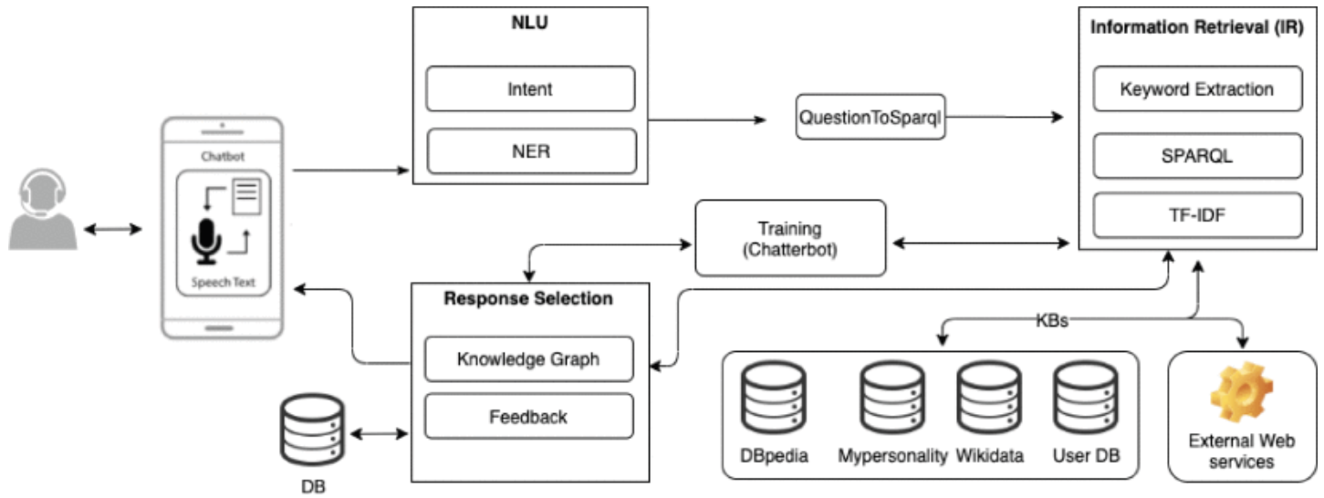
Relation to State of the Art
Chatbots for complex scenarios
[AJ20]
Notes:
Dont want to dive to deep into this but want to show how a complex chatbot could look like just as an inspirtation
Just mentioned artifacts: Intents, NLU, Knowledge Bases
Translate intents to a query to search for data in the KBs
In the end a response is selected based on the named components and a trained chatbot

Slide 57
References
[aco24] acon96. home-llm. 2024. url: https://github.com/acon96/home-llm
[AJ20] A. Ait-Mlouk, L. Jiang. “KBot: A Knowledge Graph Based ChatBot for Natural Language Understanding Over Linked Data.” In: IEEE Access 8 (2020). Conference Name: IEEE Access, pp. 149220–149230. ISSN: 2169- 3536. DOI: 10.1109/ACCESS.2020.3016142. URL: https://ieeexplore.ieee.org/abstract/document/9165716
[AM20] E. Adamopoulou, L. Moussiades. “An Overview of Chatbot Technology.” en. In: Artificial Intelligence Applications and Innovations. Ed. by I. Maglogiannis, L. Iliadis, E. Pimenidis. IFIP Advances in Information and Communication Technology. Cham: Springer International Publishing, 2020, pp. 373– 383. ISBN: 978-3-030-49186-4. DOI: 10.1007/978-3-030-49186-4_31
[APM+20] S. Ahmed, D. Paul, R. Masnun, M.U. A. Shanto, T. Farah. “Smart Home Shield and Automation System Using Facebook Messenger Chatbot.” In: 2020 IEEE Region 10 Symposium (TENSYMP). ISSN: 2642-6102. June 2020, pp. 1791–1794. DOI: 10.1109/TENSYMP50017.2020.9230716. URL: https://ieeexplore.ieee.org/abstract/document/9230716
[BKS17] C. J. Baby, F. A. Khan, J. N. Swathi. “Home automation using IoT and a chatbot using natural language processing.” In: 2017 Innovations in Power and Advanced Computing Technologies (i-PACT). Apr. 2017, pp. 1–6. DOI: 10.1109/IPACT.2017.8245185. URL: https://ieeexplore.ieee.org/abstract/document/8245185
[CA21] M. Chkroun, A. Azaria. “A Safe Collaborative Chatbot for Smart Home Assistants.” en. In: Sensors 21.19 (Jan. 2021). Number: 19 Publisher: Multidisciplinary Digital Publishing Institute, p. 6641. ISSN: 1424-8220. DOI: 10.3390/s21196641. URL: https://www.mdpi.com/1424-8220/21/19/6641
[CCI+20] D. Carlander-Reuterfelt, Á. Carrera, C. A. Iglesias, Ó. Araque, J. F. Sánchez Rada, S. Muñoz. “JAICOB: A Data Science Chatbot.” In: IEEE Access 8 (2020). Conference Name: IEEE Access, pp. 180672–180680. ISSN: 2169- 3536. DOI: 10.1109/ACCESS.2020.3024795. URL: https://ieeexplore.ieee.org/abstract/document/9200315
[JQFF23] A. Jasinski, Y. Qiao, E. Fallon, R. Flynn. “Chatbot-based Feedback for Dynamically Generated Workflows in Docker Networks.” In: 2023 IEEE 9th International Conference on Network Softwarization (NetSoft). ISSN: 2693-9789. June 2023, pp. 287–289. DOI: 10.1109/NetSoft57336.2023. 10175429. URL: https://ieeexplore.ieee.org/abstract/document/10175429
[Som11] I. Sommerville. Software Engineering. en. Google-Books-ID: l0egcQAACAAJ. Pearson, 2011. ISBN: 978-0-13-705346-9
[YMJ+24] F. Yan, H. Mao, C. C.-J. Ji, T. Zhang, S. G. Patil, I. Stoica, J. E. Gonzalez. Berkeley Function Calling Leaderboard. https://gorilla.cs.berkeley.edu/blogs/8_berkeley_function_calling_leaderboard.html 2024

Slide 58
Other Sources
[DESTATIS] Energy Data History: https://www.destatis.de/DE/Themen/Wirtschaft/Preise/Publikationen/Energiepreise/energiepreisentwicklung-pdf-5619001.pdf?__blob=publicationFile
[FLATICON] Chatbot Icon: https://www.flaticon.com/de/kostenloses-icon/chatbot_2040946
[BOSCH] Bosch Smart Home Pictures https://www.bosch-smarthome.com/

